Slide 1
Classifying Car Collisions severity

Slide 2
Business problem
Car accidents cause an average of 3,287 deaths per day worldwide.
Automotive crashes rank as the 9th leading cause of death and account for 2.2% of all deaths globally.
road crashes and road traffic deaths cost USD $518 billion globally, costing individual countries 1-2% of their annual GDP.

Slide 3
Project goal
This project aims to help the car owners know the situations and variables that might cause them into getting into car accidents through calssifying the severity of car accidents for the recorded accidents.

Slide 4
Data description
The features that will be used in our classification model are:
ADDRTYPE: Collision address type: Alley, Block or Intersection.
COLLISIONTYPE: Collision type.
PERSONCOUNT: The total number of people involved in the collision
PEDCOUNT: The number of pedestrians involved in the collision.
PEDCYLCOUNT: The number of bicycles involved in the collision.
VEHCOUNT: The number of vehicles involved in the collision.
INATTENTIONIND: Whether or not collision was due to inattention. (Y/N)
UNDERINFL: Whether or not a driver involved was under the influence of drugs or alcohol.
WEATHER: A description of the weather conditions during the time of the collision.
ROADCOND: The condition of the road during the collision.
LIGHTCOND: The light conditions during the collision.
PEDROWNOTGRNT: Whether or not the pedestrian right of way was not granted. (Y/N)
SPEEDING: Whether or not speeding was a factor in the collision. (Y/N)
HITPARKEDCAR: Whether or not the collision involved hitting a parked car. (Y/N)
SEVERITYCODE: A code that corresponds to the severity of the collision: (3—fatality, 2b—serious injury, 2—injury, 1—prop damage, 0—unknown)
The data set provided includes all types of collisions. Collisions will display at the intersection or mid-block of a segment.
Timeframe: 2004 to Present.
The Data set contained 38 features, only 15 of them will be used in our model.

Slide 5
Exploratory data analysis

Slide 6
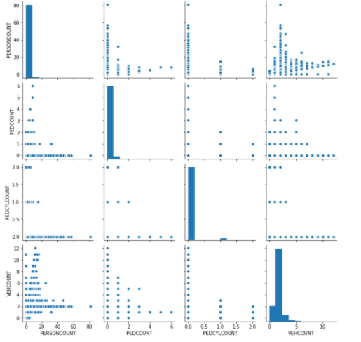
Numerical Pair plot
We examined the distribution of each feature and the correlation between numerical features.

Slide 7
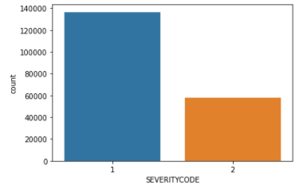
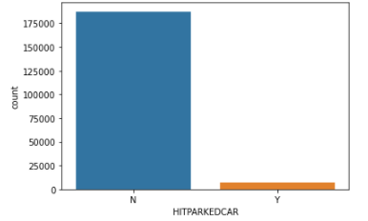
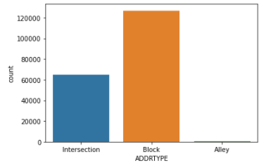
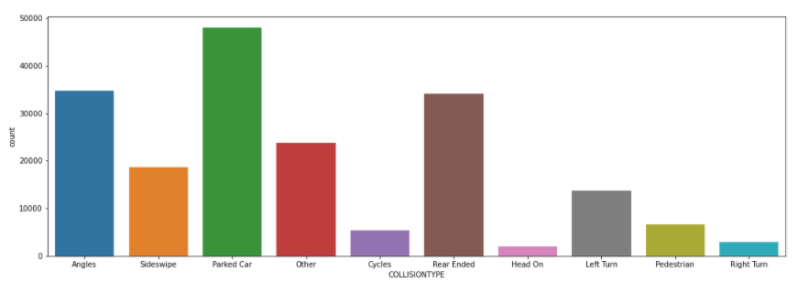
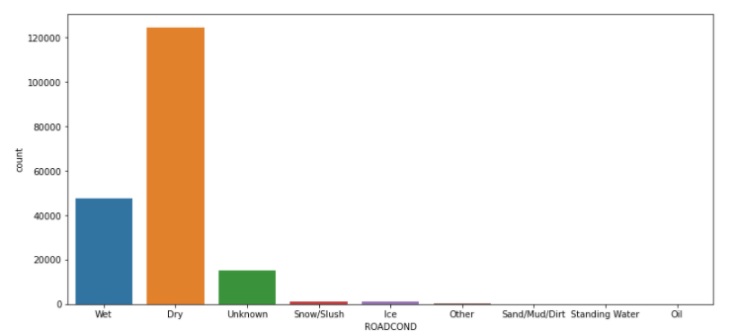
Categorical count plots

Slide 8
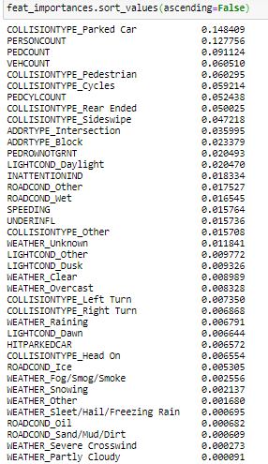
Feature selection
Feature selection was done using fitting random forest classifier and choosing features that have importance greater than “0.01”.

Slide 9
Modelling
Random forest
Decision tree
Logistic regression
K-nearest neighbors.

Slide 10
Results (1/3)
Unbalanced data | Random Forest | Logistic Regression | Decision Tree | KNN Classifier
Class_1 F-Score | 84% | 85% | 84% | 82%
Class_2 F-Score | 44% | 40% | 43% | 47%
Accuracy Score | 76% | 76% | 76% | 73%
AUC score | 0.79 | 0.79 | 0.78 | 0.72

Slide 11
Results (2/3)
Under sampled | Random Forest | Logistic Regression | Decision Tree | KNN Classifier
Class_1 F-Score | 68% | 68% | 68% | 65%
Class_2 F-Score | 72% | 72% | 72% | 69%
Accuracy Score | 70% | 70% | 70% | 67%
AUC score | 0.79 | 0.79 | 0.78 | 0.73

Slide 12
Results (3/3)
Over sampled | Random Forest | Logistic Regression | Decision Tree | KNN Classifier
Class_1 F-Score | 68% | 67% | 68% | 65%
Class_2 F-Score | 74% | 73% | 74% | 70%
Accuracy Score | 71% | 70% | 71% | 68%
AUC score | 0.8 | 0.79 | 0.8 | 0.73

Slide 13
conclusion
Predicting the severity of car accidents is a crucial problem that is of great benefit to not only individuals but also to governments that lose huge amounts of money due to them. This problem was approached in this paper where we classified the severity of collisions after processing the data, selecting the most important features and best performing model to yield accuracy rate of around 70%.

Slide 14
Future work
Handling missing data differently
Merging column values differently
Different feature selection method

